Slide 1


Non-Banking, Financial Services And Insurance (NBFSI)
Credit Risk Default Assesment of Home Credit Group
MACHINE LEARNING – 19AI613

Slide 2


THE CREW
Vivek
Gutti
CB.EN.P2AID20021
Kowtharapu Venkata Shashank CB.EN.P2AID20027
S Padmavathi
Course Instructor

Slide 3

Project Background:
Home Credit is an international Non-Banking Financial Institution (NBFC) founded in 1997 in the Czech Republic. The company operates in 14 countries and focuses on lending primarily to people with little or no credit history.
Home Credit strives to broaden financial inclusion for the unbanked population by providing a positive and safe borrowing experience. In order to make sure this underserved population has a positive loan experience, Home Credit makes use of a variety of alternative data--including Telco and transactional information--to predict their client’s repayment abilities.
Home Credit is currently using various statistical and machine learning methods to make these predictions successful. This will ensure that clients capable of repayment are not rejected and that loans are given with a principal, maturity, and repayment calendar that will empower their clients to be successful.
Objective:
To predict the home loan credit risk for the financial institution. The project will enable the bank to reduce their risk of loan loss by gaining an apt understanding its customer base, thus minimizing the loss of capital for the financial institution while reaping optimal profit

Slide 4
Data Description:
There are 307511 observations in the dataset with 122 columns that stand for both qualitative and quantitative attributes of which 67 columns have missing values.
Out of 122, 16 columns are categorical and 106 are numerical columns.
There is a binary output variable that denotes “Delay in payments” (1) or “No Delay in payments (0)”.
Source:
https://www.kaggle.com/c/home-credit-default-risk

Slide 5

Challenges:
Imbalanced Dataset
01
04
Sampling methods
Null Values
02
05
Feature Selection
Hyperparameter tuning
Size of Data
03
06

Slide 6
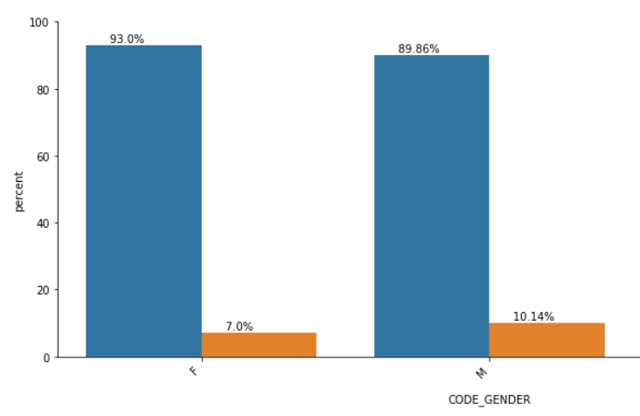
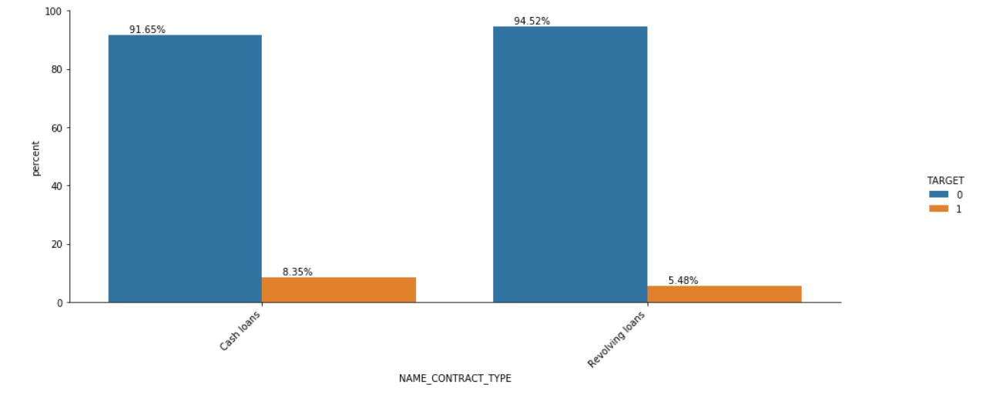

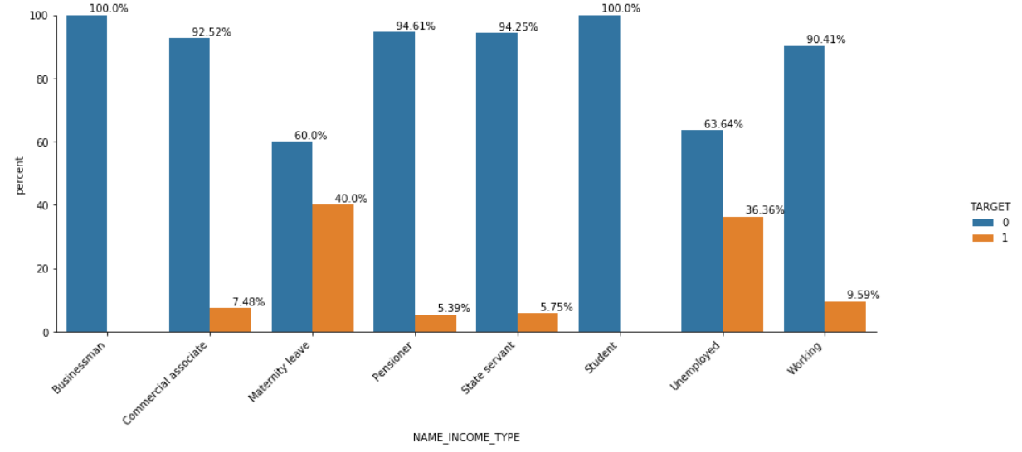
Exploratory Data Analysis

Slide 7
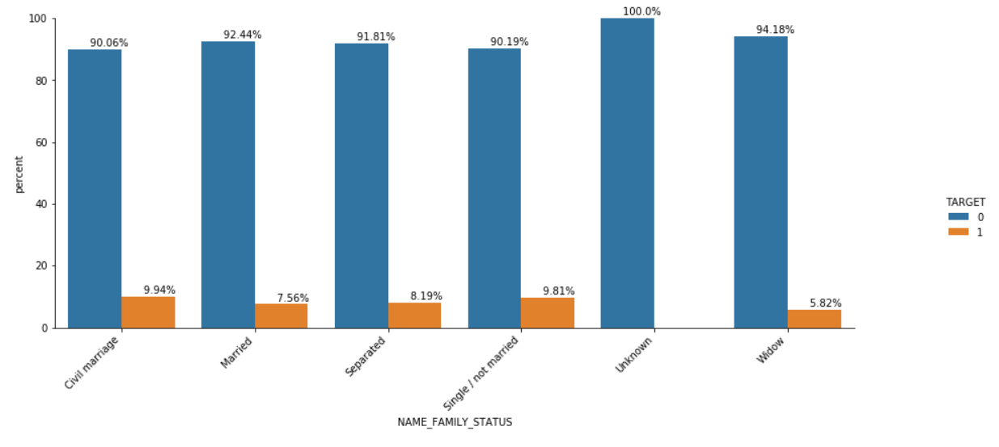
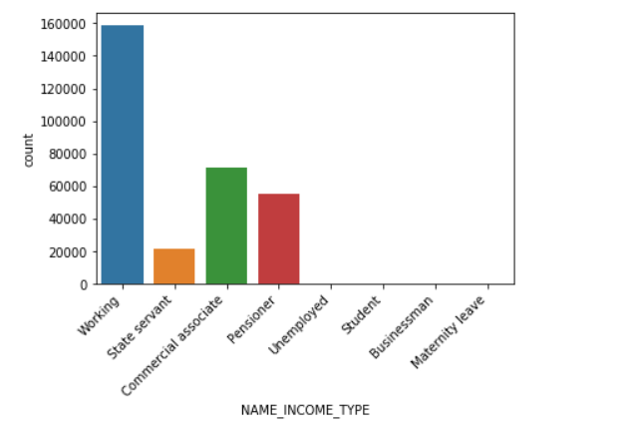
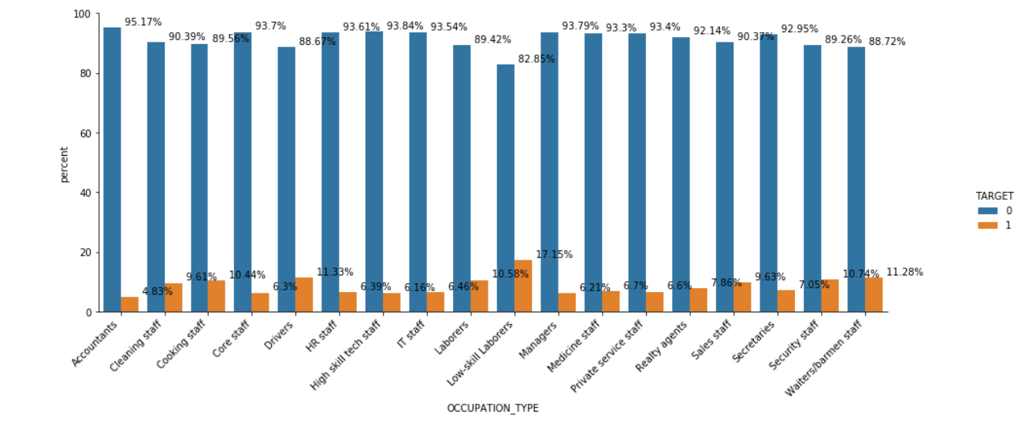
Exploratory Data Analysis

Slide 8
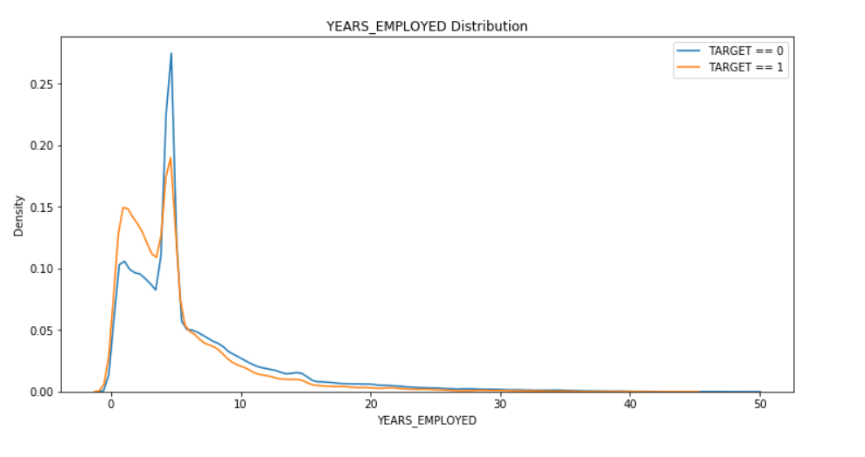
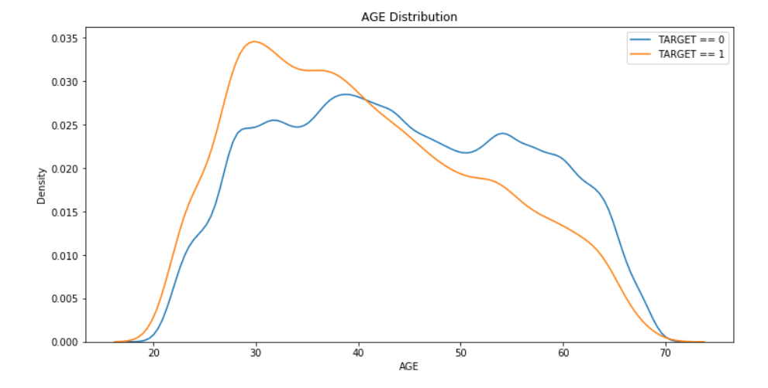
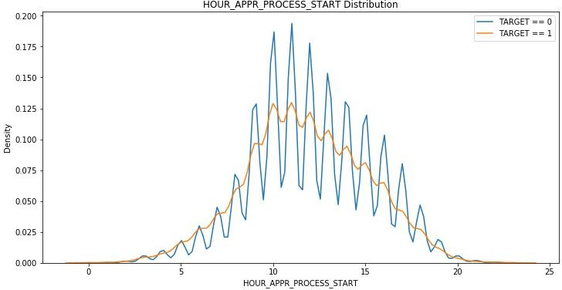
Exploratory Data Analysis

Slide 9
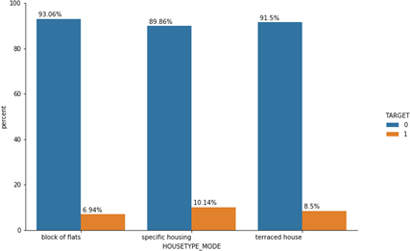
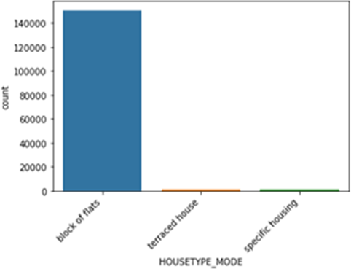
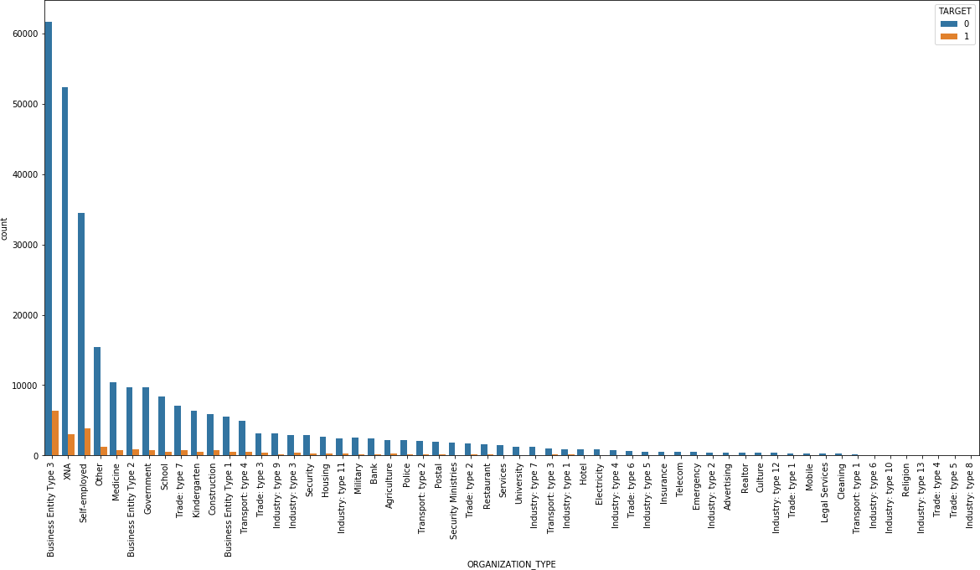
Exploratory Data Analysis

Slide 10
Base Model with imbalance target
Logistic Regression
Metrics | Training Score | Testing Score
Accuracy | 91.92 | 91.92
Precision | 0 | NA*
Recall | 0 | 0
F1_score | 0 | 0
Roc_Auc | 49.99 | 50
NA* - It’s an edge case, model hasn’t predicted any positive cases due to class imbalance

Slide 11
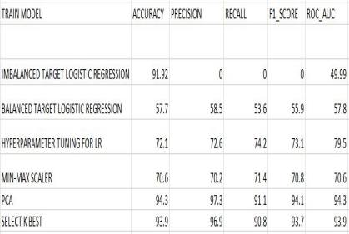
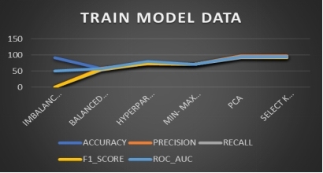

Slide 12
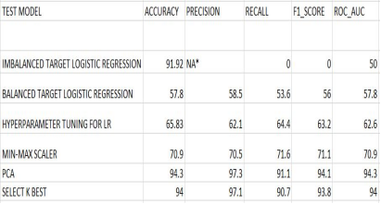
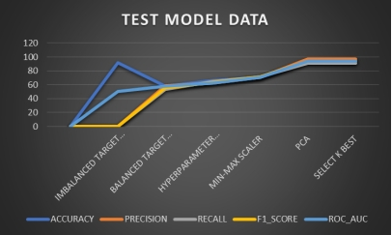

Slide 13
ALGORITHMS COMPARISION (BIAS & VARIANCE ERROR) THROUGH K-FOLD CROSS VALIDATED DATA
Random Forest
Gradient Boosting
ROC_AUC = 0.965
Bias error = 0.034665
Variance Error = 0.001051
ROC_AUC = 0.963
Bias error = 0.037947
Variance Error = 0.001160
ROC_AUC = 0.974
Bias error = 0.025761
Variance Error = 0.000852
ROC_AUC = 0.976
Bias error = 0.024310
Variance Error = 0.000785
ROC_AUC = 0.967
Bias error = 0.032695
Variance Error = 0.001143
Bagging
Ada Boost
XGBoost

Slide 14
MODEL NAME(TRAIN) | ACCURACY | PRECISION | RECALL | F1_SCORE | ROC_AUC SCORE
LOGISTIC REGRESSION | 93.92 | 96.90 | 90.75 | 93.72 | 93.92
RANDOM FOREST | 99.99 | 100 | 99.99 | 99.99 | 99.99
BAGGING CLASSIFIER | 99.31 | 99.97 | 98.64 | 99.30 | 99.31
ADA BOOST | 91.74 | 100 | 99.99 | 91.67 | 91.74
GRADIENT BOOST | 93.48 | 96.65 | 90.07 | 93.25 | 93.48
XG BOOST | 95.42 | 98.85 | 91.90 | 95.25 | 95.42

Slide 15

MODEL NAME(TEST) | ACCURACY | PRECISION | RECALL | F1_SCORE | ROC_AUC SCORE
LOGISTIC REGRESSION | 93.99 | 97.08 | 90.71 | 93.78 | 93.99
RANDOM FOREST | 95.02 | 99.48 | 90.52 | 94.79 | 95.02
BAGGING CLASSIFIER | 93.45 | 97.69 | 89.01 | 93.15 | 93.45
ADA BOOST | 91.76 | 92.60 | 90.77 | 91.68 | 91.76
GRADIENT BOOST | 93.48 | 96.67 | 90.05 | 93.24 | 94.48
XG BOOST | 95.00 | 98.42 | 91.46 | 94.81 | 95.00

Slide 16
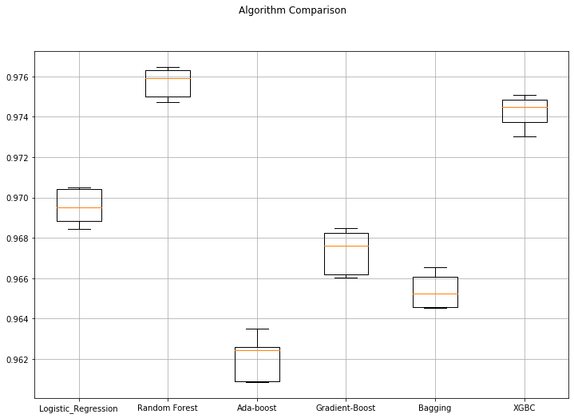
ALGORITHMS COMPARISION (BIAS & VARIANCE ERROR) THROUGH K-FOLD CROSS VALIDATED DATA
We observed that XGBC model is performing better on both train and test data. So we are finalizing best model as XGBC model.

Slide 17
Final Model
XGBC | Train Scores | Test Scores
Accuracy | 95.42 | 95.00
Precision | 98.85 | 98.42
Recall | 91.90 | 91.46
F1_score | 95.25 | 94.81
Roc_Auc score | 95.42 | 95.00
When we observe train and test scores, XGBoost is performing well. Considering this model as best model

Slide 18
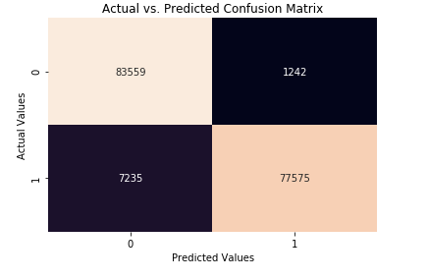
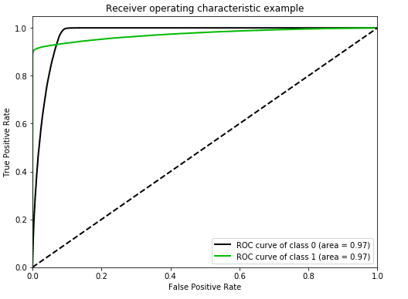

Final Model
Cross-Validation Score

Slide 19
Thank You..!

